Slide 1
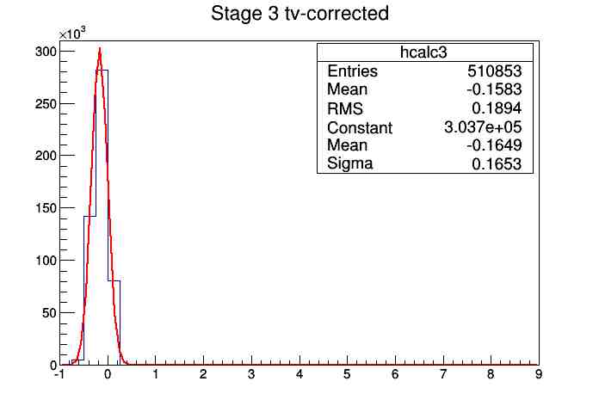
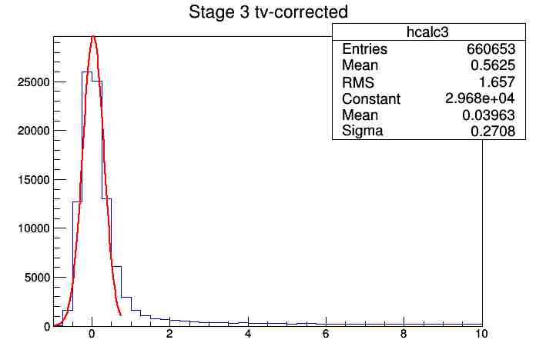
A first look at WEPL noise in May 2015 run at CDH V.A.Bashkirov, June 2nd 2015
Detector noise (background, PMTs, electronics, light leak etc.) looks normal, though there is some additional noise or, most likely, low energy deposition in some cases. Pedestals in MeV have our normal sigma in 0.1-0.16 range, stage 3 is most noisy.
4briks+step
“empty” (air)

Slide 2
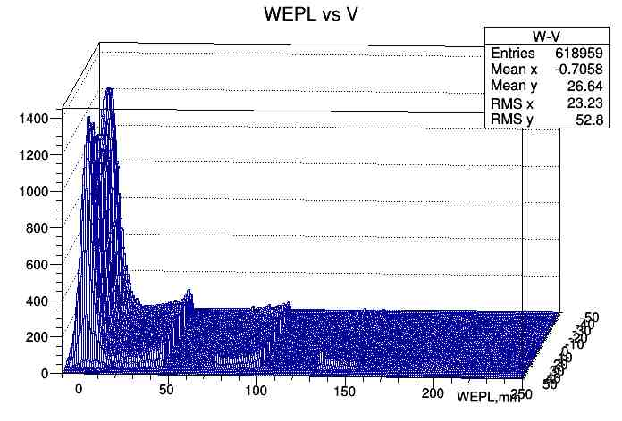
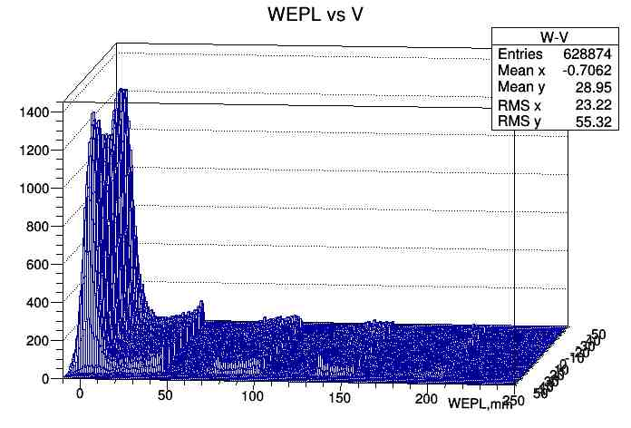
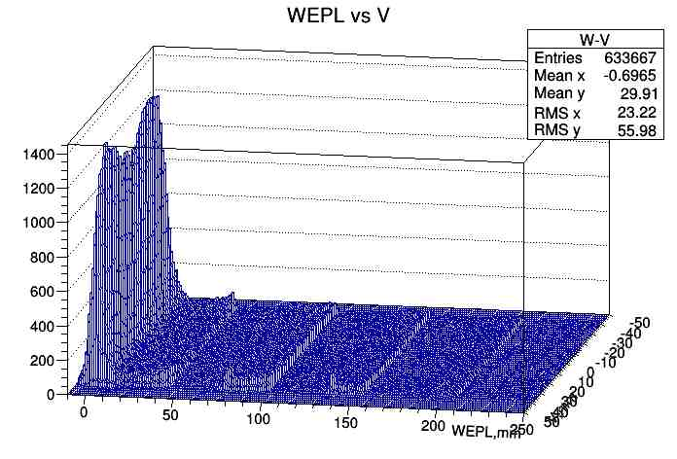
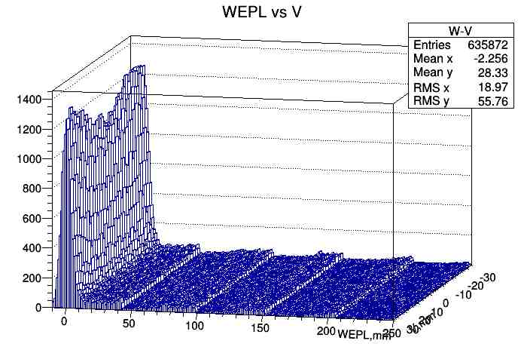
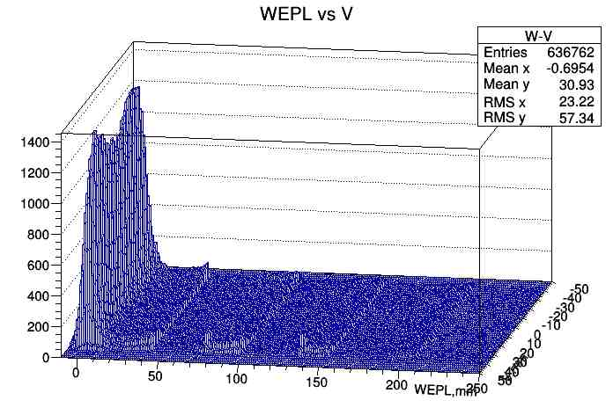
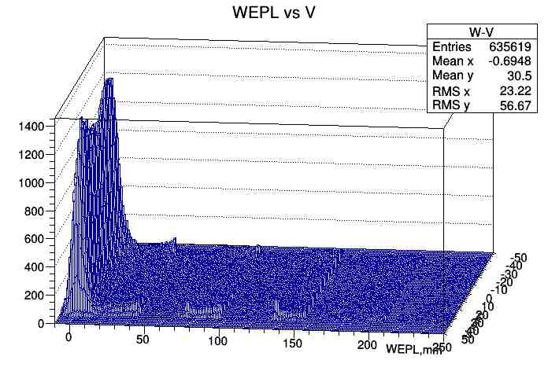
This “noise”/real low energy deposition results in wrong WEPL, and can be partially suppressed close to stage interface by setting a higher threshold in WEPL reconstruction (presently SetEthresholds(1,1,1,1,1), in MeV), see below events distribution in “empty” run vs WEPL and V ( to show an excess of such events close to top and bottom of the detector)
Thresholds: 0.5, 0.5, 0.5, 0.5, 0.5 1,1,1,1,1 1,1,1,1,4.5
Thresholds: 1,2,3,4.5.4 1,1,1,4.5,4.5 1,2,3,4.5,5.5

Slide 3
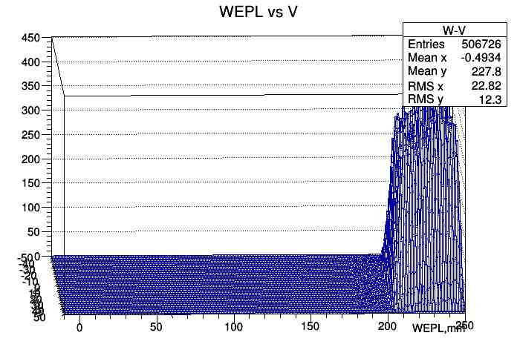
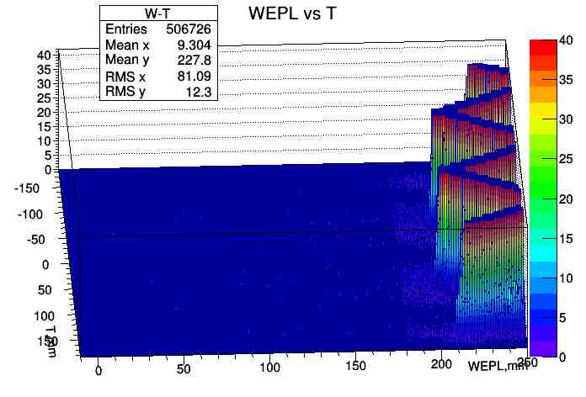
Much less of such events occurs when proton stops in the first stage, even at low 0.5 MeV threshold (step+4 briks):

Slide 4
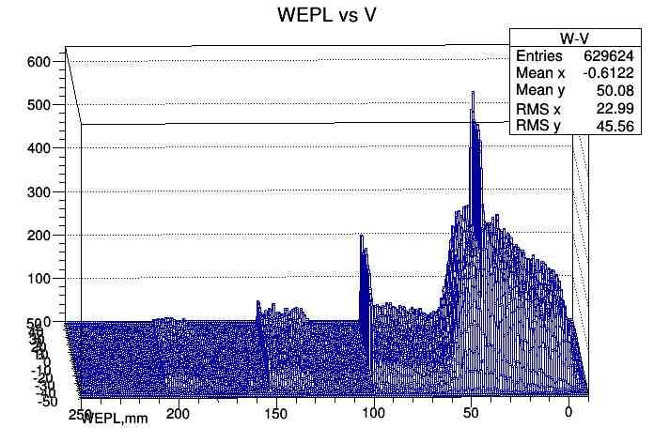
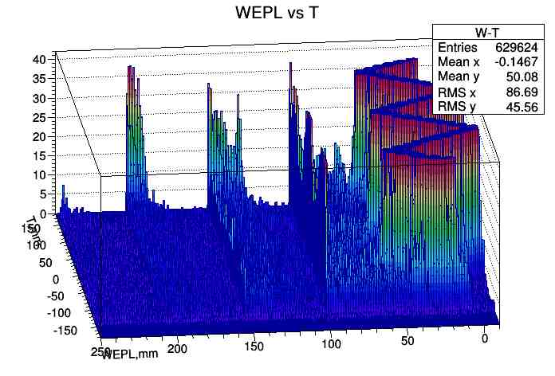
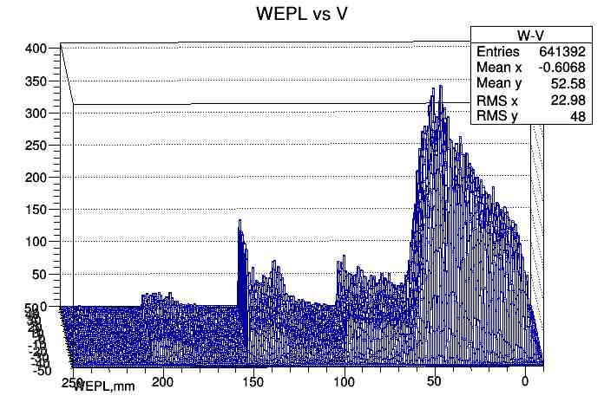
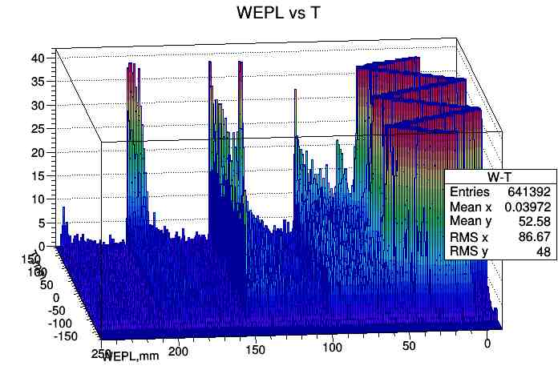
For just step phantom, all thresholds 1 MeV we see a lot of “wrong” WEPL events. Low energy proton hallo?
Thresholds set to 1, 1, 1, 4.5, 4.5 MeV; suppressed peaks at interface of stages 3&4 but most of “wrong” events still there.

